Slide 1
Lectures 29-34 Abstract Algebra and Applications
N D Gangadhar

Slide 2
Intended Learning Outcomes
At the end of the lectures, the student will be able to
Describe relations and explain their properties
Describe the concepts and properties of Boolean Algebra
Explain the application of relations for Relational Data Modelling, Relational Databases and their operations
Explain representations of relations and their closures
Explain Equivalence Relations, Classes and Partitions
Explain Partial Orderings on sets and Lattices
Explain Boolean Functions and their representations
Explain how Logic Gates and Circuits can be used for realiasation of Boolean Functions

Slide 3
Topics
Relations and Their Properties
Relational Data Modelling and Databases
Representation of Relations
Closure of Relations
Equivalence Relations
Partial Orderings
Lattices
Boolean Algebra
Boolean Functions
Representation of Boolean Functions
Logic Gates and Circuits

Slide 4
Section 1: Relations and Their Properties

Slide 5
Section Outline
Relations and Functions
Properties of Relations
Reflexive Relations
Symmetric and Antisymmetric Relations
Transitive Relations
Combining Relations

Slide 6
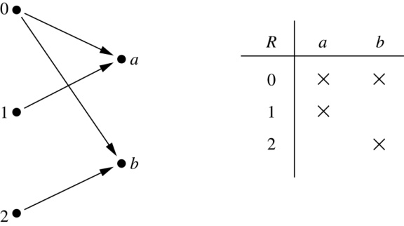
Binary Relations
Definition: A binary relation R from a set A to a set B is a subset R ⊆ A × B.
Example:
Let A = {0,1,2} and B = {a,b}
{(0, a), (0, b), (1,a) , (2, b)} is a relation from A to B.
We can represent relations from a set A to a set B graphically or using a table:
Relations are more general than functions.
A function is a relation where exactly one element of B is related to each element of A.

Slide 7
Binary Relation on a Set
Definition: A binary relation R on a set A is a subset of A × A or a relation from A to A.
Example:
Suppose that A = {a,b,c}. Then R = {(a,a),(a,b), (a,c)} is a relation on A.
Let A = {1, 2, 3, 4}.
The ordered pairs in the relation R = {(a,b) | a divides b} are
(1,1), (1, 2), (1,3), (1, 4), (2, 2), (2, 4), (3, 3), and (4, 4).

Slide 8
Binary Relation on a Set
Question: How many relations are there on a set A?

Slide 9
Binary Relation on a Set
Question: How many relations are there on a set A?
Solution: Because a relation on A is the same thing as a subset of A ⨉ A, we count the subsets of A × A. Since A × A has n² elements when A has n elements, and a set with m elements has 2^{m} subsets, there are
subsets of A × A.
Therefore, there are relations on a set A.

Slide 10
Binary Relations on a Set
Example: Consider these relations on the set of integers:
R₁ = {(a,b) | a ≤ b}, R₄ = {(a,b) | a = b},
R₂ = {(a,b) | a > b}, R₅ = {(a,b) | a = b + 1},
R₃ = {(a,b) | |a| = |b\ }, R₆ = {(a,b) | a + b ≤ 3}.
Note that these relations are on an infinite set and each of these relations is an infinite set.
For each of these pairs, determine to which relations it belongs
(1,1), (1, 2), (2, 1), (1, −1), and (2, 2)

Slide 11
Binary Relations on a Set
Example: Consider these relations on the set of integers:
R₁ = {(a,b) | a ≤ b}, R₄ = {(a,b) | a = b},
R₂ = {(a,b) | a > b}, R₅ = {(a,b) | a = b + 1},
R₃ = {(a,b) | |a| = |b\ }, R₆ = {(a,b) | a + b ≤ 3}.
Note that these relations are on an infinite set and each of these relations is an infinite set.
For each of these pairs, determine to which relations it belongs
(1,1), (1, 2), (2, 1), (1, −1), and (2, 2)
Solution: Checking the conditions that define each relation, we see that the pair (1,1) is in R₁, R₃, R₄ , and R₆: (1,2) is in R₁ and R₆: (2,1) is in R₂, R₅, and R₆: (1, −1) is in R₂, R₃, and R₆ : (2,2) is in R₁, R₃, and R₄.

Slide 12
Reflexive Relations
Definition: R is reflexive iff (a,a) ∊ R for every element a ∊ A. Written symbolically, R is reflexive if and only if
∀x[x∊A ⟶ (x,x) ∊ R]
Example: The following relations on the set of integers are reflexive:
R₁ = {(a,b) | a ≤ b},
R₃ = {(a,b) | |a| = |b| },
R₄ = {(a,b) | a = b}.
The following relations are not reflexive:
R₂ = {(a,b) | a > b} (note that 3 ≯ 3),
R₅ = {(a,b) | a = b + 1} (note that 3 ≠3 + 1),
R₆ = {(a,b) | a + b ≤ 3} (note that 4 + 4 ≰ 3).
If A = ∅ then the empty relation is reflexive vacuously: The empty relation on an empty set is reflexive!

Slide 13
Symmetric Relations
Definition: R is symmetric iff (b,a) ∊ R whenever (a,b) ∊ R for all a,b ∊ A. Written symbolically, R is symmetric if and only if
∀x∀y [(x,y) ∊R ⟶ (y,x) ∊ R]
Example: The following relations on the integers are symmetric:
R₃ = {(a,b) | |a| = |b|},
R₄ = {(a,b) | a = b},
R₆ = {(a,b) | a + b ≤ 3}.
The following are not symmetric:
R₁ = {(a,b) | a ≤ b} (note that 3 ≤ 4, but 4 ≰ 3),
R₂ = {(a,b) | a > b} (note that 4 > 3, but 3 ≯ 4),
R₅ = {(a,b) | a = b + 1} (note that 4 = 3 + 1, but 3 ≠4 + 1).

Slide 14
Antisymmetric Relations
Definition:A relation R on a set A such that for all a,b ∊ A if (a,b) ∊ R and (b,a) ∊ R, then a = b is called antisymmetric. Written symbolically, R is antisymmetric if and only if
∀x∀y [(x,y) ∊R ∧ (y,x) ∊ R ⟶ x = y]
Example: The following relations on the integers are antisymmetric:
R₁ = {(a,b) | a ≤ b},
R₂ = {(a,b) | a > b},
R₄ = {(a,b) | a = b},
R₅ = {(a,b) | a = b + 1}.
The following relations are not antisymmetric:
R₃ = {(a,b) | |a| = |b| }
(note that both (1,−1) and (−1,1) belong to R₃),
R₆ = {(a,b) | a + b ≤ 3} (note that both (1,2) and (2,1) belong to R₆).
The property “symmetric” and “antisymmetric” are not opposite. A relation may have both or neither.
For any integer, if a a ≤ b and a ≤ b , then a = b.
Notes:
Note: the property “symmetric” and “antisymmetric” are not opposite. A relation may have both or neither.

Slide 15
Transitive Relations
Definition: A relation R on a set A is called transitive if whenever (a,b) ∊ R and (b,c) ∊ R, then (a,c) ∊ R, for all a,b,c ∊ A. Written symbolically, R is transitive if and only if
∀x∀y ∀z[(x,y) ∊R ∧ (y,z) ∊ R ⟶ (x,z) ∊ R ]
Example: The following relations on the integers are transitive:
R₁ = {(a,b) | a ≤ b},
R₂ = {(a,b) | a > b},
R₃ = {(a,b) | |a| = |b| },
R₄ = {(a,b) | a = b}.
The following are not transitive:
R₅ = {(a,b) | a = b + 1} (note that both (4,3) and (3,2) belong to R₅, but not (4,2)),
R₆ = {(a,b) | a + b ≤ 3} (note that both (2,1) and (1,2) belong to R₆, but not (2,2)).
For every integer, a ≤ b
and b ≤ c, then b ≤ c.

Slide 16
Combining Relations
Given two relations R₁ and R₂, we can combine them using basic set operations to form new relations such as R₁ ∪ R₂, R₁ ∩ R₂, R₁ − R₂, and R₂ − R₁.
Example: Let A = {1,2,3} and B = {1,2,3,4}. The relations R₁ = {(1,1),(2,2),(3,3)} and R₂ = {(1,1),(1,2),(1,3),(1,4)} can be combined using basic set operations to form new relations:
R₁ ∪ R₂ ={(1,1),(1,2),(1,3),(1,4),(2,2),(3,3)}
R₁ ∩ R₂ ={(1,1)}
R₁ − R₂ ={(2,2),(3,3)}
R₂ − R₁ ={(1,2),(1,3),(1,4)}

Slide 17
Composition
Definition: Suppose
R₁ is a relation from a set A to a set B.
R₂ is a relation from B to a set C.
Then the composition (or composite) of R₂ with R₁, is a relation from A to C where
If (x,y) is a member of R₁ and (y,z) is a member of R₂, then (x,z) is a member of R₂∘ R₁.

Slide 18
Representing the Composition of a Relation
R₁
R₂
w
m
a
x
n
b
y
o
c
p
z

Slide 19
Composition of a Relation with Itself
Definition: Suppose R is a relation on a set A.
Then the composition (or composite) of R with R, denoted by R∘ R, is a relation on A where
If (x,y) is a member of R and (y,z) is a member of R, then (x,z) is a member of R∘ R.
Example: Let R be the relation on the set of all people such that (a, b) is in R if person a is parent of person b. Then (a, c) is in (R∘ R) iff there is a person b such that (a, b) is in R and (b, c) is in R. In other words, (a, c) is in R if and only if a is a grandparent of c.

Slide 20
Powers of a Relation
Definition: Let R be a binary relation on A. Then the powers R^{n} of the relation R can be defined recursively by:
Basis Step: R¹ = R
Recursive Step: R^{n+1} = R^{n} ∘ R
The powers of a transitive relation are subsets of the
relation. This is established by the following theorem:
Theorem: The relation R on a set A is transitive iff R^{n} ⊆ R for all positive integers n.
(A proof via mathematical induction can be given)

Slide 21
N-ary relations
Definition: Let A1, A2, ..., An be sets. An n-ary relation on these sets is a subset of A1 x A2 x ... x An. The sets A1, A2, ..., An are called the domains of the relation and n is called the degree.
Example: Let R be the ternary relation on Z x Z x Z+ consisting of triples (a, b, m) where
Then (-1, 9, 5), (8, 2, 3) and (14, 0, 7) belong to R, but
(7, 2, 3) does not.
Example: Let R’ be the relation consisting of 5-tuples
(A, N, S, D, T) representing airplane flights, where A is the airline, N is the flight number, S is the starting point, D is the destination and T is the departure time. The degree of this relation is 5.

Slide 22
Section 2: Relational Data Modelling and Databases

Slide 23
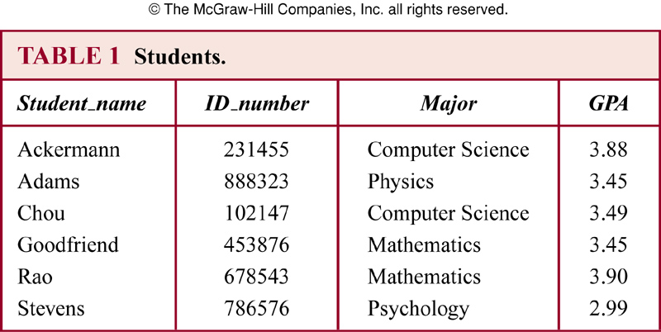
Databases and Relations
Relations are often used to represent databases
Relations used to represent databases are also called tables, because they are often displayed as tables
The database query language SQL (Structured Query Language) is used to carry out operations on tables
Each column of the table corresponds to an attribute

Slide 24
Relational Data Model
Relational data model
Records
Fields
Tables
Primary key

Slide 25
Operations on n-array Relations
Definition: Let R be an n-ary relation and C a condition that elements in R may satisfy. Then the selection operator S_{C} maps the n-ary relation R to the n-ary relation of all n-tuples from R that satisfy the condition C.
Definition: The projection P_{i1i2…im} where i1<i2<…<im, maps the n-tuple (a₁,a₂,…,a_{n}) to the m-tuple (a_{i1},a_{i2},…,a_{im}), where m<=n.

Slide 26
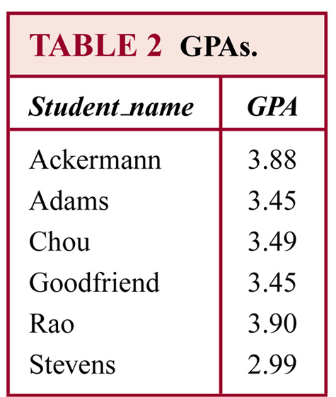
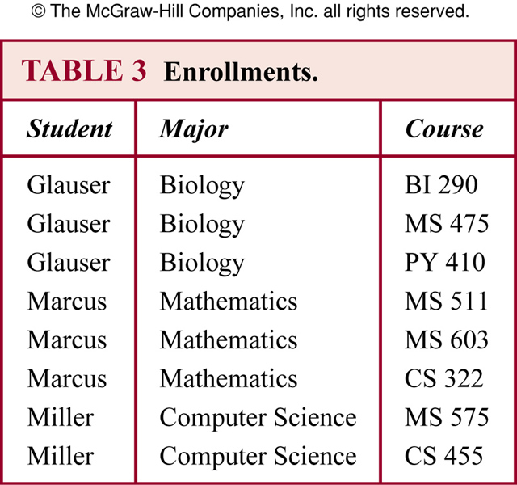
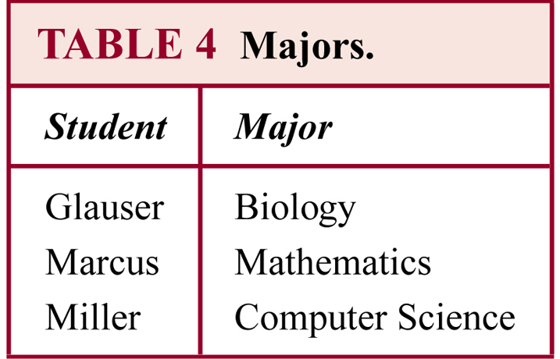
Operations on Database Relations

Slide 27
Natural Join
The natural join binary operator combines two tables into one, when these tables share some identical fields.
The result of the natural join between R and S is the set of all combinations of tuples in R and S that are equal on their common attribute names.
Example
A table contains fields for airline, flight number, and gate
A second table contains fields for flight number, gate, and departure time.
One can use natural join to combine these two relations into a third one containing fields for airline, flight number, gate and departure time.

Slide 28
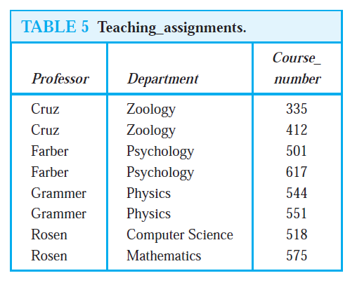
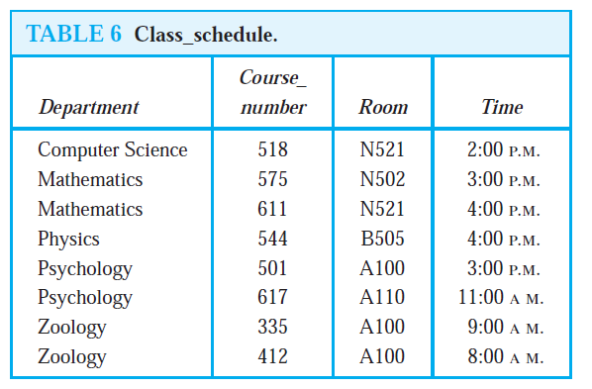
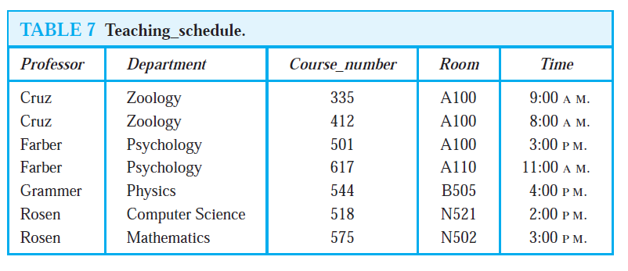
(Table 5) Natural Join (Table 6) = (Table 7)

Slide 29
Natural Join
Definition: Let R be a relation of degree m and S a relation of degree n. The join J_{p}(R,S), where p≤m and p≤n, is a relation of degree m+n-p that consists of all (m+n-p)-tuples (a₁,a₂,…,a_{m-p},c₁,c₂,…,c_{p},b₁,b₂,…,b_{n-p}), where the m-tuple (a₁,a₂,…,a_{m-p},c₁,c₂,…,c_{p}) belongs to R and the n-tuple (c₁,c₂,…,c_{p},b₁,b₂,…,b_{n-p}) belongs to S.

Slide 30
Section 3: Representation of Relations

Slide 31
Section Outline
Representing Relations using Matrices
Representing Relations using Digraphs

Slide 32
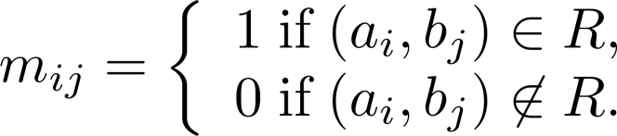
Representing Relations Using Matrices
A relation between finite sets can be represented using a zero-one matrix.
Suppose R is a relation from A = {a₁, a₂, …, a_{m}} to B = {b₁, b₂, …, b_{n}}.
The elements of the two sets can be listed in any particular arbitrary order. When A = B, we use the same ordering.
The relation R is represented by the m x n matrix M_{R} = [m_{ij}], where
The matrix representing R has a 1 as its (i,j) entry when a_{i} is related to b_{j} and a 0 if a_{i} is not related to b_{j}.

Slide 33
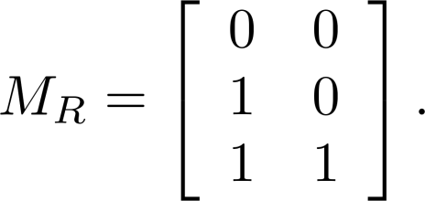
Examples of Representing Relations Using Matrices
Example 1: Suppose that A = {1,2,3} and B = {1,2}. Let R be the relation from A to B containing (a,b) if a ∈ A, b ∈ B, and a > b. What is the matrix representing R (assuming the ordering of elements is the same as the increasing numerical order)?
Solution: Because R = {(2,1), (3,1),(3,2)}, the matrix is

Slide 34
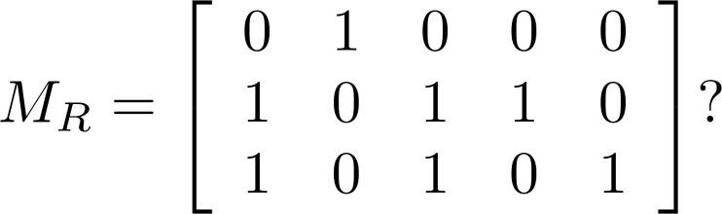
Examples of Representing Relations Using Matrices (cont.)
Example 2: Let A = {a₁,a₂, a₃} and B = {b₁,b₂, b₃,b₄, b₅}. Which ordered pairs are in the relation R represented by the matrix

Slide 35
Examples of Representing Relations Using Matrices
Example 2: Let A = {a₁,a₂, a₃} and B = {b₁,b₂, b₃,b₄, b₅}. Which ordered pairs are in the relation R represented by the matrix
Solution: Because R consists of those ordered pairs (a_{i},b_{j}) with m_{ij} = 1, it follows that:
R = {(a₁, b₂), (a₂, b₁),(a₂, b₃), (a₂, b₄),(a₃, b₁), {(a₃, b₃), (a₃, b₅)}.

Slide 36
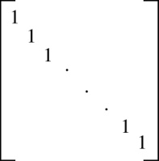
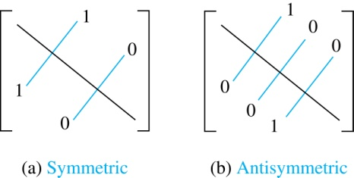
Matrices of Relations on Sets
If R is a reflexive relation, all the elements on the main diagonal of M_{R} are equal to 1.
R is a symmetric relation, if and only if m_{ij} = 1 whenever m_{ji} = 1. R is an antisymmetric relation, if and only if m_{ij} = 0 or m_{ji} = 0 when i≠ j.

Slide 37
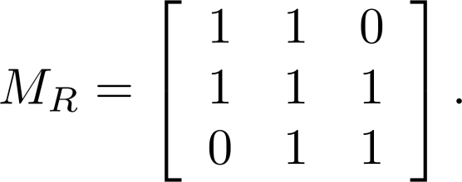
Example of a Relation on a Set
Example 3: Suppose that the relation R on a set is represented by the matrix
Is R reflexive, symmetric, and/or antisymmetric?

Slide 38
Example of a Relation on a Set
Example 3: Suppose that the relation R on a set is represented by the matrix
Is R reflexive, symmetric, and/or antisymmetric?
Solution: Because all the diagonal elements are equal to 1, R is reflexive. Because M_{R} is symmetric, R is symmetric and not antisymmetric because both m_{1,2} and m_{2,1} are 1.

Slide 39
Matrices for Combinations of Relations
The matrix of the union of two relations is the join (Boolean OR) between the matrices of the component relations
The matrix of the intersection of two relations if the meet (Boolean AND) between the matrices of the component relations
The matrix of the composite relation (R∘ R) is the Boolean Product between the matrix representing R and itself.

Slide 40
Joins and Meets of Zero-One Matrices (Recall)
Definition: Let A = [a_{ij}] and B = [b_{ij}] be an m × n zero-one matrices.
The join of A and B is the zero-one matrix with (i,j)th entry a_{ij} ∨ b_{ij}. The join of A and B is denoted by A ∨ B.
The meet of of A and B is the zero-one matrix with (i,j)th entry a_{ij} ∧ b_{ij}. The meet of A and B is denoted by A ∧ B.

Slide 41
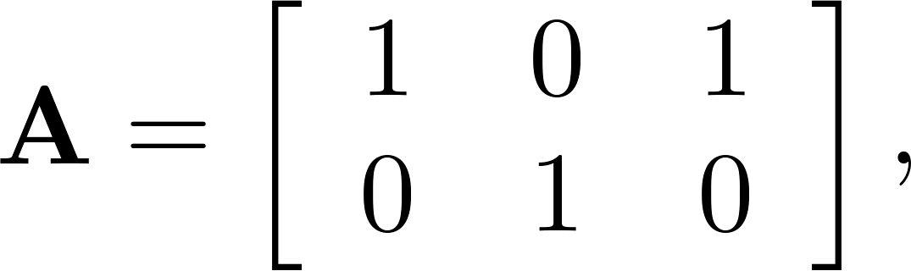
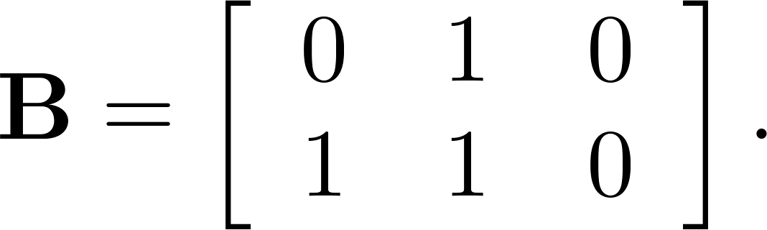
Joins and Meets of Zero-One Matrices (Recall)
Example: Find the join and meet of the zero-one matrices

Slide 42
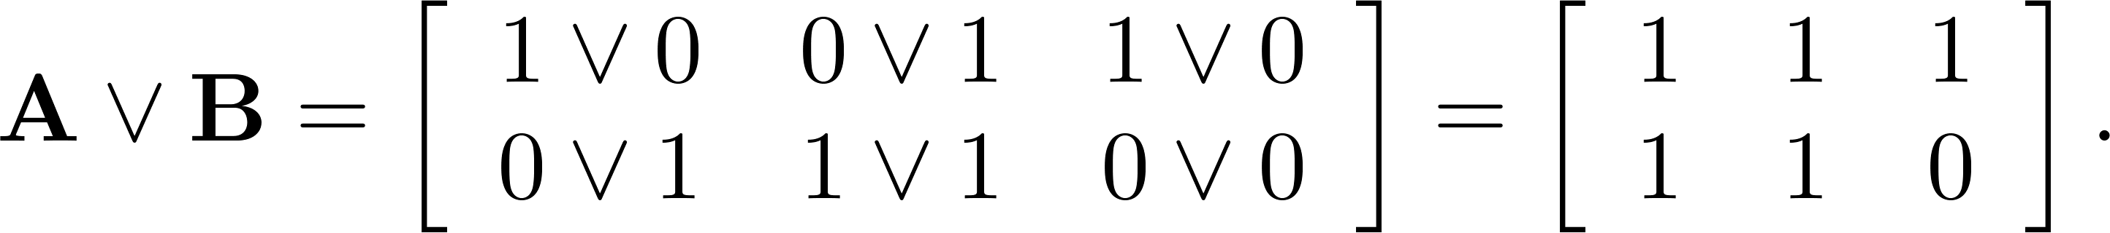
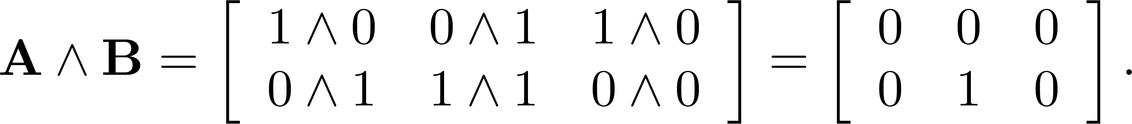
Joins and Meets of Zero-One Matrices (Recall)
Example: Find the join and meet of the zero-one matrices
Solution: The join of A and B is
The meet of A and B is

Slide 43
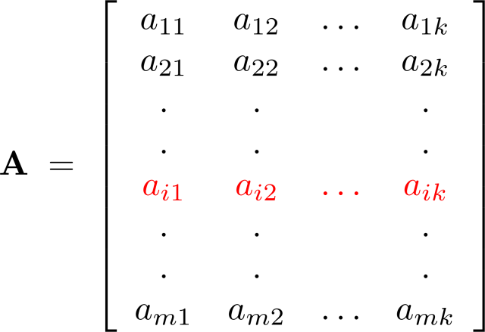
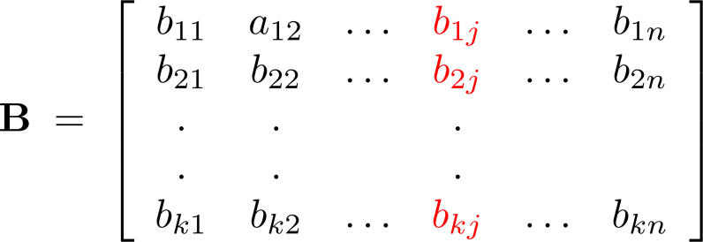
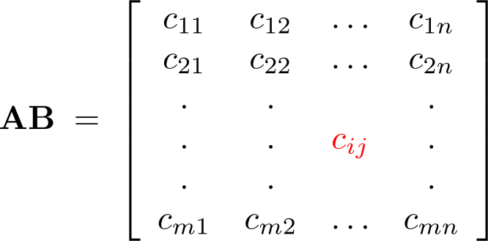
Recall Matrix Multiplication
The product of an (mxk) matrix A = [a_{is}], and
a (k x n) matrix B = [b_{sj}] is

Slide 44

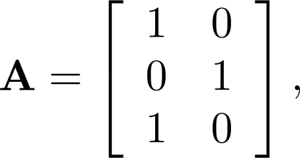
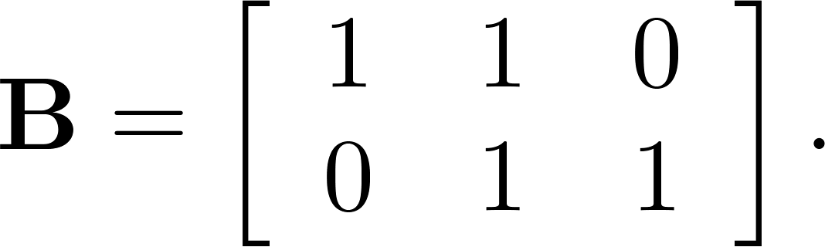
Boolean Product of Zero-One Matrices (Recall)
Definition: Let A = [a_{is}] be an m k zero-one matrix and B = [b_{sj}] be a k n zero-one matrix. The Boolean product of A and B, denoted by A ⊙ B, is the m n zero-one matrix with the (i,j)th entry defined as
c_{ij} = (a_{i1} ∧ b_{1j})∨ (a_{i2} ∧ b_{2j}) ∨ … ∨ (a_{ik} ∧ b_{kj}).
Example: Find the Boolean product of A and B, where
Continued on next slide →

Slide 45
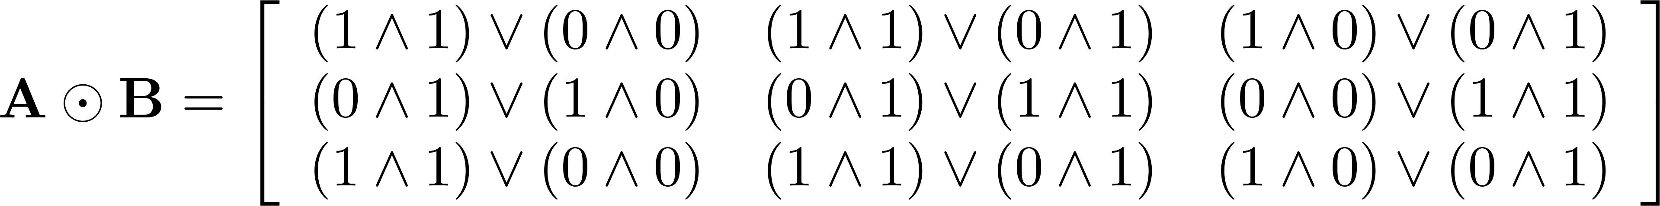
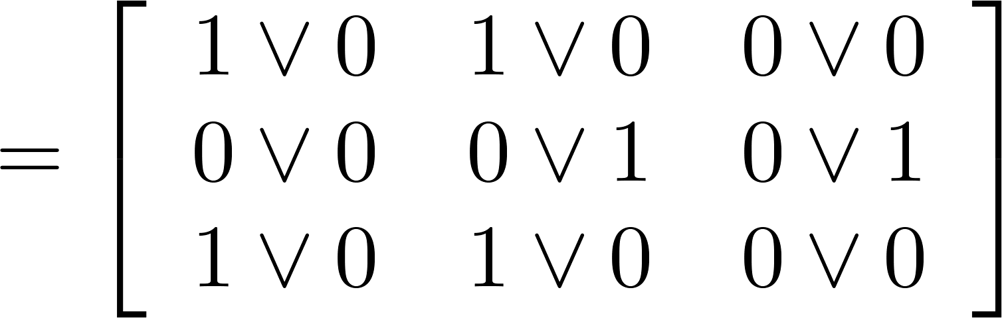
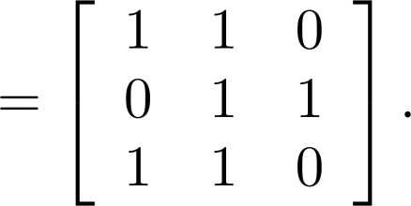
Boolean Product of Zero-One Matrices (Recall)
Solution: The Boolean product A ⊙ B is given by

Slide 46
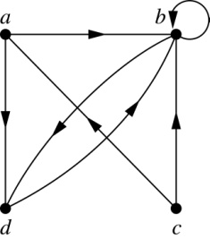
Representing Relations Using Digraphs
Definition: A directed graph, or digraph, consists of a set V of vertices (or nodes) together with a set E of ordered pairs of elements of V called edges (or arcs). The vertex a is called the initial vertex of the edge (a,b), and the vertex b is called the terminal vertex of this edge.
An edge of the form (a,a) is called a loop.
Example 7: A drawing of the directed graph with vertices a, b, c, and d, and edges (a, b), (a, d), (b, b), (b, d), (c, a), (c, b), and (d, b) is shown here.

Slide 47
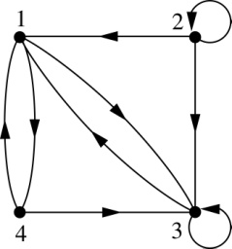
Examples of Digraphs Representing Relations
Example 8: What are the ordered pairs in the relation represented by this directed graph?
Solution: The ordered pairs in the relation are
(1, 3), (1, 4), (2, 1), (2, 2), (2, 3), (3, 1), (3, 3), (4, 1), and (4, 3)

Slide 48
Determining Properties of a Relation from its Digraph
Reflexivity: A loop must be present at all vertices in the graph.
Symmetry: If (x,y) is an edge, then so is (y,x).
Antisymmetry: If (x,y) with x ≠ y is an edge, then (y,x) is not an edge.
Transitivity: If (x,y) and (y,z) are edges, then so is (x,z).

Slide 49
Determining Properties of a Relation from its Digraph
a
b
c
d
Reflexive? No, not every vertex has a loop
Symmetric? Yes (trivially), there is no edge from any one vertex to another
Antisymmetric? Yes (trivially), there is no edge from any one vertex
to another
Transitive? Yes, (trivially) since there is no edge from any one vertex to another

Slide 50
Determining Properties of a Relation from its Digraph
a
b
c
d

Slide 51
Determining Properties of a Relation from its Digraph
a
b
c
d
Reflexive? No, there are no loops
Symmetric? No, there is an edge from a to b, but not from b to a
Antisymmetric? No, there is an edge from d to b and b to d
Transitive? No, there are edges from a to c and from c to b,
but there is no edge from a to d

Slide 52
Determining Properties of a Relation from its Digraph
a
b
c
d

Slide 53
Determining Properties of a Relation from its Digraph
a
b
c
d
Reflexive? No, there are no loops
Symmetric? No, for example, there is no edge from c to a
Antisymmetric? Yes, whenever there is an edge from one
vertex to another, there is not one going back
Transitive? Yes

Slide 54
Determining Properties of a Relation from its Digraph
b
a
c
d

Slide 55
Determining Properties of a Relation from its Digraph
b
a
c
d
Reflexive? No, there are no loops
Symmetric? No, for example, there is no edge from d to a
Antisymmetric? Yes, whenever there is an edge from one vertex
to another, there is not one going back
Transitive? Yes (trivially), there are no two edges where the first
edge ends at the vertex where the second edge begins

Slide 56
Example of the Powers of a Relation
a
b
a
b
d
c
d
c
R
R²
a
b
a
b
d
c
R⁴
d
c
R³
The pair (x,y) is in R^{n} if there is a path of length n from x to y in R
(following the direction of the arrows).

Slide 57
Section 4: Closure of Relations

Slide 58
Closure of a Relation
Definition: Let R be a relation on a set A. R may or may not have some property P. If there is a relation S with property P containing R such that S is a subset of every relation with property P containing R, then S is called the closure of R with respect to P.
S: the smallest relation that contains R
Example: Telephone call connection

Slide 59
Closures
Reflexive closure
Ex: R={(1,1),(1,2),(2,1),(3,2)} on the set A={1,2,3}
The smallest relation contains R?
The reflexive closure of R=R∪∆, where
∆ = {(a,a)|a∈A}
Symmetric closure
The symmetric closure of R=R∪R⁻¹, where
R⁻¹ ={(b,a)|(a,b)∈R}
Transitive closure
More complex

Slide 60
Paths in Directed Graphs
Definition: A path from a to b in the directed graph G is a sequence of edges (x0,x1), (x1,x2), …,(xn-1,xn) in G, where n is a nonnegative integer, and x0=a and xn = b.
The path denoted by x0,x1,…,xn-1, xn has length n.
A path of length n >=1 that begins and ends at the same vertex is called a circuit or cycle.
There is a path from a to b in R if there is a sequence of elements a, x1, x2, …, xn-1, b with (a,x1)∈R, (x1,x2)∈R, …, and (xn-1,b)∈R.

Slide 61
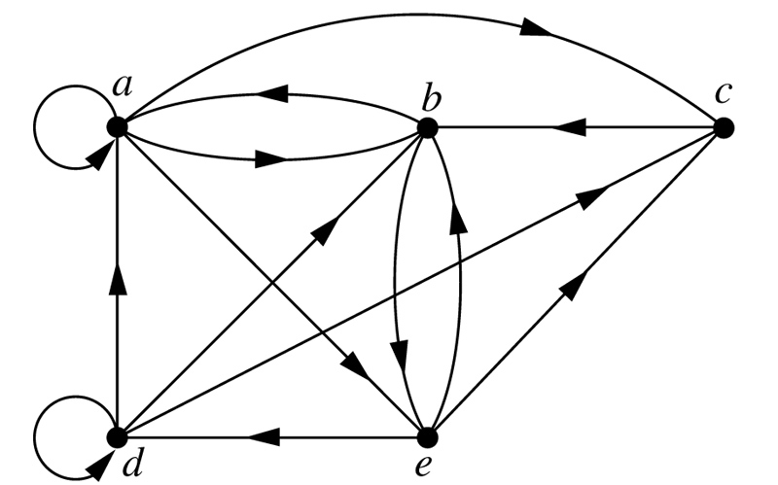
Paths in Directed Graph of a Relation

Slide 62
Paths in Directed Graph of a Relation
Theorem: Let R be a relation on a set A. There is a path of length n, where n is a positive integer, from a to b iff
(a,b)∈R^{n}.
Proof. (by mathematical induction)

Slide 63
Transitive Closure
Definition: Let R be a relation on a set A. The connectivity relation R* consists of pairs (a,b) such that there is a path of length at least one from a to b in R.
R*= ∪_{n=1..∞}R^{n}.
Theorem: The transitive closure of a relation R equals the connectivity relation R*.

Slide 64
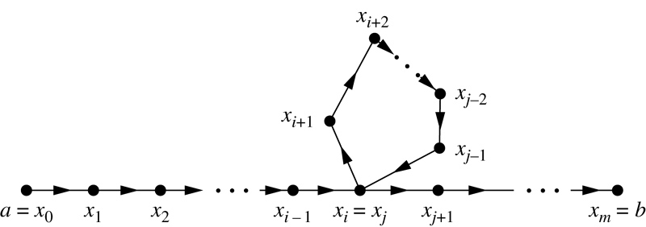
Transitive Closure
Lemma: Let A be a set with n elements, and R be a relation on A. If there is a path of length at least one in R from a to b, then there is such as path with length not exceeding n.
When a≠b, if there is a path of length at least one in R from a to b, then there is such as path with length not exceeding n-1.

Slide 65
Transitive Closure
Theorem: Let M_{R} be the zero-one matrix of the relation R on a set with n elements. Then the zero-one matrix of the transitive closure R* is
M_{R*} = M_{R} ∨ M_{R}^{[2]} ∨ M_{R}^{[3]} ∨… ∨ M_{R}^{[n]}.

Slide 66
Section 5: Equivalence Relations

Slide 67
Section Outline
Equivalence Relations
Equivalence Classes
Equivalence Classes and Partitions

Slide 68
Equivalence Relations
Definition 1: A relation on a set A is called an equivalence relation if it is reflexive, symmetric, and transitive.
Definition 2: Two elements a, and b that are related by an equivalence relation are called equivalent. The notation a ∼ b is often used to denote that a and b are equivalent elements with respect to a particular equivalence relation.

Slide 69
Strings
Example: Suppose that R is the relation on the set of strings of English letters such that aRb if and only if l(a) = l(b), where l(x) is the length of the string x. Is R an equivalence relation?
Solution: Show that all of the properties of an equivalence relation hold.
Reflexivity: Because l(a) = l(a), it follows that aRa for all strings a.
Symmetry: Suppose that aRb. Since l(a) = l(b), l(b) = l(a) also holds and bRa.
Transitivity: Suppose that aRb and bRc. Since l(a) = l(b),and l(b) = l(c), l(a) = l(c) also holds and aRc.

Slide 70
Congruence Modulo m
Example: Let m be an integer with m > 1. Show that the relation
R = {(a,b) | a ≡ b (mod m)}
is an equivalence relation on the set of integers.

Slide 71
Congruence Modulo m
Example: Let m be an integer with m > 1. Show that the relation
R = {(a,b) | a ≡ b (mod m)}
is an equivalence relation on the set of integers.
Solution: Recall that a ≡ b (mod m) if and only if m divides a − b.
Reflexivity: a ≡ a (mod m) since a − a = 0 is divisible by m since 0 = 0 ∙ m.
Symmetry: Suppose that a ≡ b (mod m). Then a − b is divisible by m, and so a − b = km, where k is an integer. It follows that b − a = (− k) m, so b ≡ a (mod m).
Transitivity: Suppose that a ≡ b (mod m) and b ≡ c (mod m). Then m divides both a − b and b − c. Hence, there are integers k and l with a − b = km and b − c = lm. We obtain by adding the equations:
a − c = (a − b) + (b − c) = km + lm = (k + l) m.
Therefore, a ≡ c (mod m).

Slide 72
Divides
Example: Show that the “divides” relation on the set of positive integers is not an equivalence relation.

Slide 73
Divides
Example: Show that the “divides” relation on the set of positive integers is not an equivalence relation.
Solution: The properties of reflexivity, and transitivity do hold, but there relation is not symmetric. Hence, “divides” is not an equivalence relation.
Reflexivity: a ∣ a for all a.
Not Symmetric: For example, 2 ∣ 4, but 4 ∤ 2. Hence, the relation is not symmetric.
Transitivity: Suppose that a divides b and b divides c. Then there are positive integers k and l such that b = ak and c = bl. Hence, c = a(kl), so a divides c. Therefore, the relation is transitive.

Slide 74
Equivalence Classes
Definition 3: Let R be an equivalence relation on a set A. The set of all elements that are related to an element a of A is called the equivalence class of a. The equivalence class of a with respect to R is denoted by [a]_{R}.
When only one relation is under consideration, we can write [a], without the subscript R, for this equivalence class.
Note that [a]_{R} = {s|(a,s) ∈ R}.
If b ∈ [a]_{R}, then b is called a representative of this equivalence class. Any element of a class can be used as a representative of the class.
The equivalence classes of the relation congruence modulo m are called the congruence classes modulo m. The congruence class of an integer a modulo m is denoted by [a]_{m}, so [a]_{m} = {…, a−2m, a−m, a+m, a+2m, … }. For example,
[0]₄ = {…, −8, −4 , 0, 4 , 8 , …} [1]₄ = {…, −7, −3 , 1, 5 , 9 , …}
[2]₄ = {…, −6, −2 , 2, 6 , 10 , …} [3]₄ = {…, −5, −1 , 3, 7 , 11 , …}

Slide 75
Equivalence Classes and Partitions
Theorem: Let R be an equivalence relation on a set A. These statements for elements a and b of A are equivalent:
(i) aRb
(ii) [a] = [b]
(iii) [a] ∩ [b] ≠ ∅
Proof: We show that (i) implies (ii). Assume that aRb. Now suppose that c ∈ [a]. Then aRc. Because aRb and R is symmetric, bRa. Because R is transitive and bRa and aRc, it follows that bRc. Hence, c ∈ [b]. Therefore, [a]⊆ [b]. A similar argument (omitted here) shows that [b]⊆ [a]. Since [a]⊆ [b] and [b]⊆ [a], we have shown that [a] = [b].

Slide 76
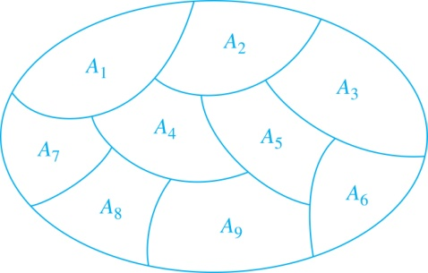
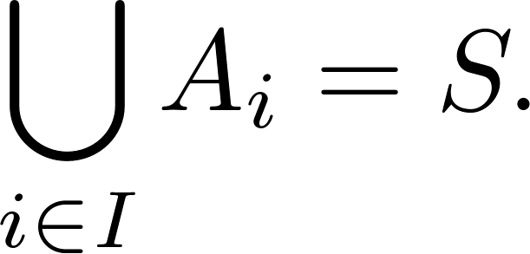
Partition of a Set
Definition: A partition of a set S is a collection of disjoint nonempty subsets of S that have S as their union. In other words, the collection of subsets A_{i}, where i ∈ I (where I is an index set), forms a partition of S if and only if
A_{i} ≠ ∅ for i ∈ I,
A_{i} ∩ A_{j}=∅ when i ≠ j,
and
A Partition of a Set

Slide 77
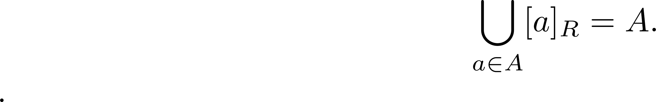
An Equivalence Relation Partitions a Set
Let R be an equivalence relation on a set A. The union of all the equivalence classes of R is all of A, since an element a of A is in its own equivalence class [a]_{R}. In other words,
From Theorem 1, it follows that these equivalence classes are either equal or disjoint, so [a]_{R} ∩[b]_{R}=∅ when [a]_{R} ≠ [b]_{R}.
Therefore, the equivalence classes form a partition of A, because they split A into disjoint subsets.

Slide 78
An Equivalence Relation Partitions a Set
Theorem: Let R be an equivalence relation on a set S. Then the equivalence classes of R form a partition of S. Conversely, given a partition {A_{i} | i ∈ I} of the set S, there is an equivalence relation R that has the sets A_{i}, i ∈ I, as its equivalence classes.
Proof: We have already shown the first part of the theorem.
For the second part, assume that {A_{i} | i ∈ I} is a partition of S. Let R be the relation on S consisting of the pairs (x, y) where x and y belong to the same subset A_{i} in the partition. We must show that R satisfies the properties of an equivalence relation.
Reflexivity: For every a ∈ S, (a,a) ∈ R, because a is in the same subset as itself.
Symmetry: If (a,b) ∈ R, then b and a are in the same subset of the partition, so (b,a) ∈ R.
Transitivity: If (a,b) ∈ R and (b,c) ∈ R, then a and b are in the same subset of the partition, as are b and c. Since the subsets are disjoint and b belongs to both, the two subsets of the partition must be identical. Therefore, (a,c) ∈ R since a and c belong to the same subset of the partition.

Slide 79
Section 6: Partial Orderings

Slide 80
Section Outline
Partial Orderings and Partially-ordered Sets
Lexicographic Orderings

Slide 81
Partial Orderings
Definition: A relation R on a set S is called a partial ordering, or partial order, if it is reflexive, antisymmetric, and transitive.
A set together with a partial ordering R is called a partially ordered set, or poset, and is denoted by (S, R). Members of S are called elements of the poset.

Slide 82
Partial Orderings
Example 1: Show that the “greater than or equal” relation (≥) is a partial ordering on the set of integers.
Reflexivity: a ≥ a for every integer a.
Antisymmetry: If a ≥ b and b ≥ a , then a = b.
Transitivity: If a ≥ b and b ≥ c , then a ≥ c.
These properties all follow from the order axioms for the integers.

Slide 83
Partial Orderings
Example 2: Show that the divisibility relation (∣) is a partial ordering on the set of integers.

Slide 84
Partial Orderings
Example 2: Show that the divisibility relation (∣) is a partial ordering on the set of integers.
Reflexivity: a ∣ a for all integers a. (see Example 9 in Section 9.1)
Antisymmetry: If a and b are positive integers with a | b and b | a, then a = b. (see Example 12 in Section 9.1)
Transitivity: Suppose that a divides b and b divides c. Then there are positive integers k and l such that b = ak and c = bl. Hence, c = a(kl), so a divides c. Therefore, the relation is transitive.
Hence, (Z⁺, ∣) is a poset.

Slide 85
Partial Orderings
Example 3: Show that the inclusion relation (⊆) is a partial ordering on the power set of a set S.

Slide 86
Partial Orderings
Example 3: Show that the inclusion relation (⊆) is a partial ordering on the power set of a set S.
Reflexivity: A ⊆ A whenever A is a subset of S.
Antisymmetry: If A and B are positive integers with A ⊆ B and B ⊆ A, then A = B.
Transitivity: If A ⊆ B and B ⊆ C, then A ⊆ C.
The properties all follow from the definition of set inclusion.

Slide 87
Comparability
Definition 2: The elements a and b of a poset (S,≼ ) are comparable if either a ≼ b or b ≼ a. When a and b are elements of S so that neither a ≼ b nor b ≼ a, then a and b are called incomparable.
The symbol ≼ is used to denote the relation in any poset.
Definition 3: If (S,≼ ) is a poset and every two elements of S are comparable, S is called a totally ordered or linearly ordered set, and ≼ is called a total order or a linear order. A totally ordered set is also called a chain.
Definition 4: (S,≼ ) is a well-ordered set if it is a poset such that ≼ is a total ordering and every nonempty subset of S has a least element.
Example: (Z, ≤) is a totally ordered set. (Z, |) is a partially ordered but not totally ordered set. (N, ≤) is a well-ordered set.

Slide 88
Lexicographic Order
Definition: Given two posets (A₁,≼₁) and (A₂,≼₂), the lexicographic ordering on A₁ ⨉ A₂ is defined by specifying that (a₁, a₂) is less than (b₁,b₂), that is,
(a₁, a₂) ≺ (b₁,b₂),
either if a₁ ≺₁ b₁ or if a₁ = b₁ and a₂ ≺₂ b₂.
This definition can be easily extended to a lexicographic ordering on strings .
Example: Consider strings of lowercase English letters. A lexicographic ordering can be defined using the ordering of the letters in the alphabet. This is the same ordering as that used in dictionaries.
discreet ≺ discrete, because these strings differ in the seventh position and e ≺ t.
discreet ≺ discreetness, because the first eight letters agree, but the second string is longer.

Slide 89
Total and Well Ordering
Definition: If (S, ) is a poset and every two elements of S are comparable, S is called a totally ordered or linearly ordered set (or a chain), and is called a total order or a linear order.
Examples: (Z, ≤), (Z+, |)
Definition 4: (S, ) is a well-ordered set if it is a poset such that is a total ordering and every nonempty subset of S has a least element.

Slide 90
Principle of Well Ordered Induction
Theorem (The Principle of Well-Ordered Induction): Suppose that S is a well-ordered set. Then P(x) is true for all x∈S, if (inductive step): For every y∈S, if P(x) is true for all x∈S with x y, then P(y) is true.

Slide 91
Hasse Diagrams
Hasse Diagrams: Some edges do not have to be shown
Reflexive: Loops can be removed
Transitive: If (a,b) and (b,c), then (a,c) can be removed
Remove all the arrows

Slide 92
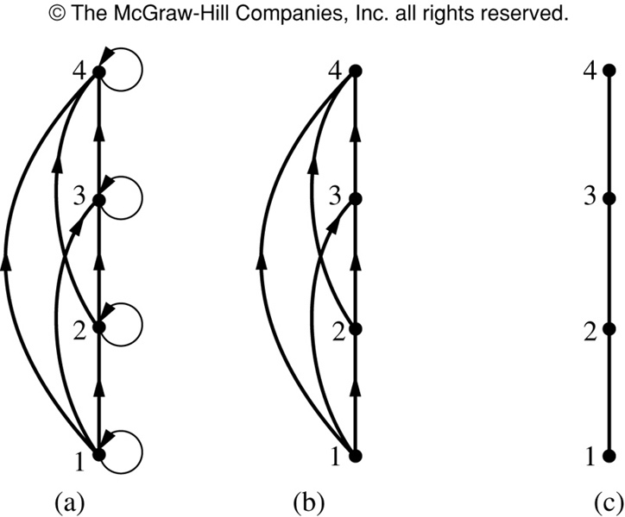
Constructing Hasse Diagram of ({1,2,3,4},≦)

Slide 93
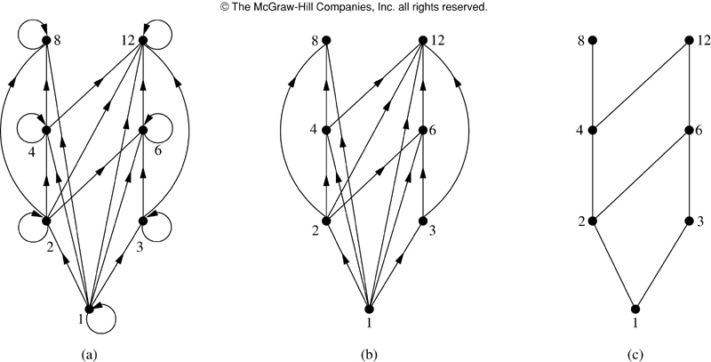
Constructing the Hasse Diagram of ({1,2,3,4,6,8,12},｜)

Slide 94
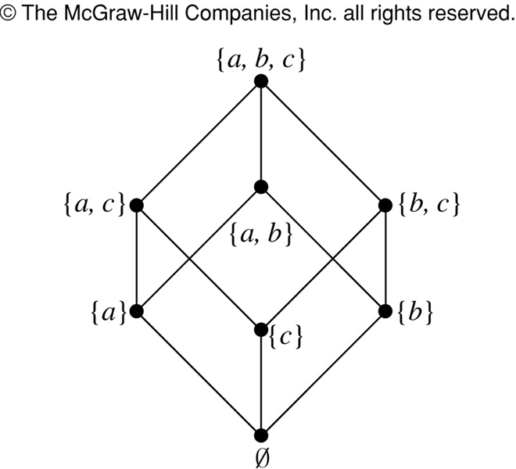
Hasse Diagram of (P({a,b,c}), )

Slide 95
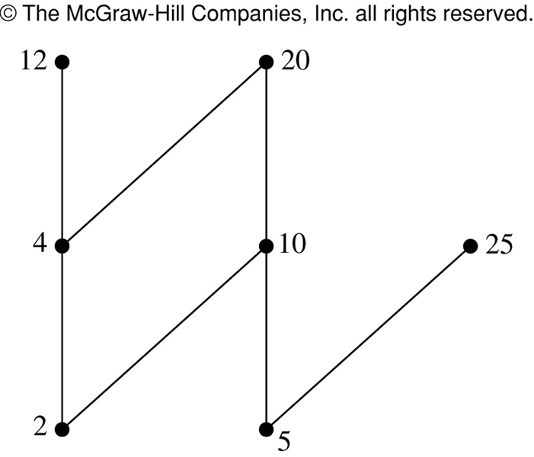
Maximal and Minimal Elements
a is maximal in the poset (S, ) if there is no b∈S such that a b;
a is minimal in the poset (S, ) if there is no b∈S such that b a;

Slide 96
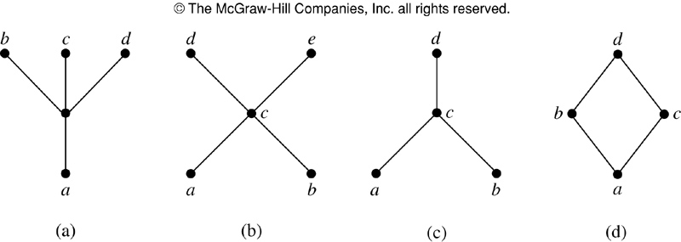
Maximal and Minimal Elements

Slide 97
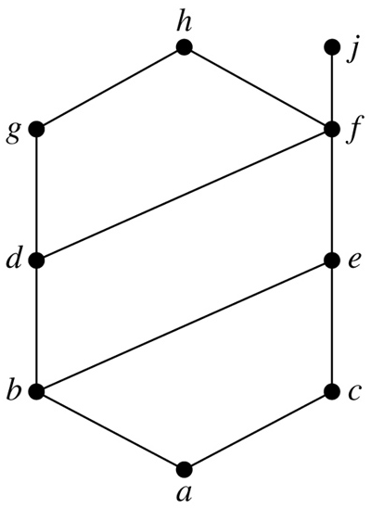
Upper and Lower Bounds
In a subset A of a poset (S, ≤), if u is an element of S such that a ≤ u for all a∈A, then u is an upper bound of A.
In a subset A of a poset (S, ≤), if l is an element of S such that l ≤ a for all a∈A, then l is an lower bound of A.

Slide 98
Section 7: Lattices
N D Gangadhar

Slide 99
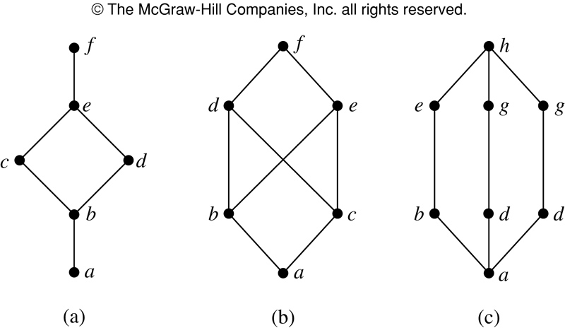
Lattices
A partially ordered set in which every pair of elements has both a least upper bound and a greatest lower bound is called a lattice

Slide 100
Topological Sorting
A total ordering ≤ is said to be compatible with the partial ordering R if a ≤ b whenever a R b.
Topological sorting is constructing a compatible total ordering from a partial ordering
Lemma: Every finite nonempty poset (S, ≤) has at lease one minimal element

Slide 101
Topological Sorting Algorithm
Procedure topological sort (S, ≤: finite poset) k := 1
while S≠ ∅
begin
ak := a minimal element of S
S := S – {ak}
k := k+1
end

Slide 102
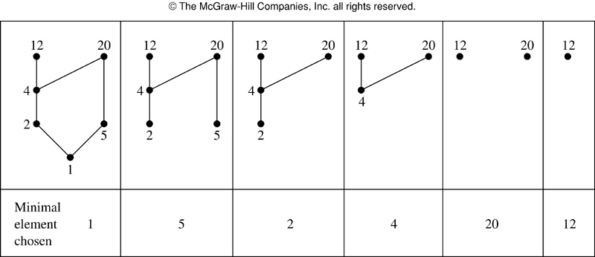
Topological Sorting

Slide 103
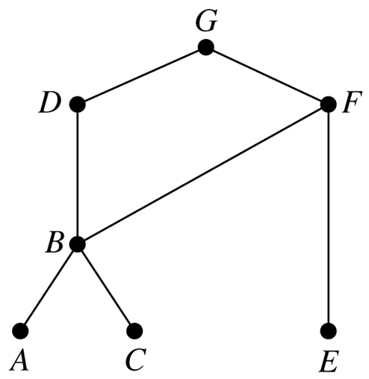
Topological Sorting

Slide 104
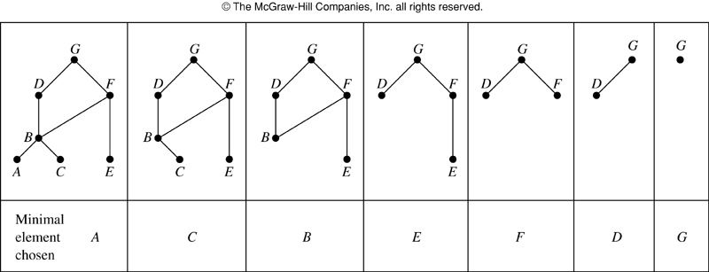
Topological Sorting

Slide 105
Section 8: Boolean Algebra
N D Gangadhar

Slide 106
Section Outline
Boolean Functions
Representation of Boolean Functions
Logic Gates
Minimisation of Circuits

Slide 107
What is Boolean Algebra?
A minor generalization of propositional logic
In general, an algebra is any mathematical structure satisfying certain standard algebraic axioms.
Such as associative/commutative/transitive laws
General theorems that are proved about an algebra then apply to any structure satisfying these axioms
Boolean algebra just generalizes the rules of propositional logic to sets other than {T, F}
E.g., to the set {0, 1} of base-2 digits, or the set {V_{L}, V_{H}} of low and high voltage levels in a circuit.
We will see that this algebraic perspective lends itself to the design of digital logic circuits
Claude Shannon’s Masters Thesis

Slide 108
Section 9: Boolean Functions

Slide 109
Outline
Boolean Sum, Product, Complement
Boolean expressions and Functions
Boolean algebra identities
Duality
Abstract Boolean algebra

Slide 110
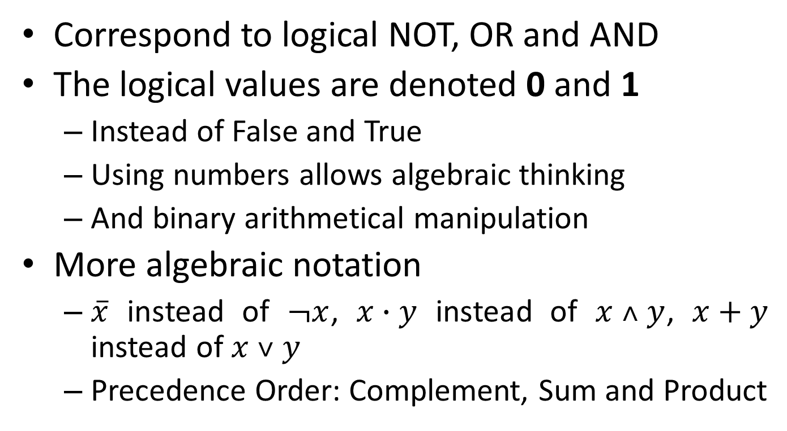
Complement, Sum and Product
Correspond to logical NOT, OR and AND
The logical values are denoted 0 and 1
Instead of False and True
Using numbers allows algebraic thinking
And binary arithmetical manipulation
More algebraic notation
$\overline{x}$ instead of $¬x$, $x∙y$ instead of $x ˄ y$, $x+y$ instead of $x ˅ y$
Precedence Order: Complement, Sum and Product

Slide 111
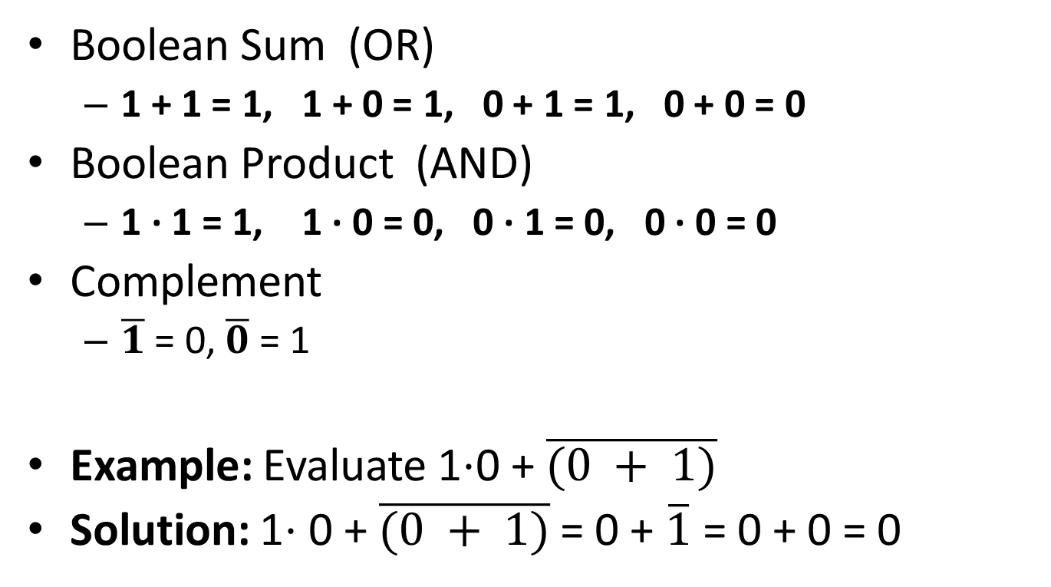
Boolean Arithmetic
Boolean Sum (OR)
1 + 1 = 1, 1 + 0 = 1, 0 + 1 = 1, 0 + 0 = 0
Boolean Product (AND)
1 · 1 = 1, 1 · 0 = 0, 0 · 1 = 0, 0 · 0 = 0
Complement
$\overline{1}$ = 0,$\overline{0}$ = 1
Example: Evaluate 1⋅0 + $\overline{(0 + 1)}$
Solution: 1⋅ 0 + $\overline{(0 + 1)}$ = 0 + $\overline{1}$ = 0 + 0 = 0

Slide 112
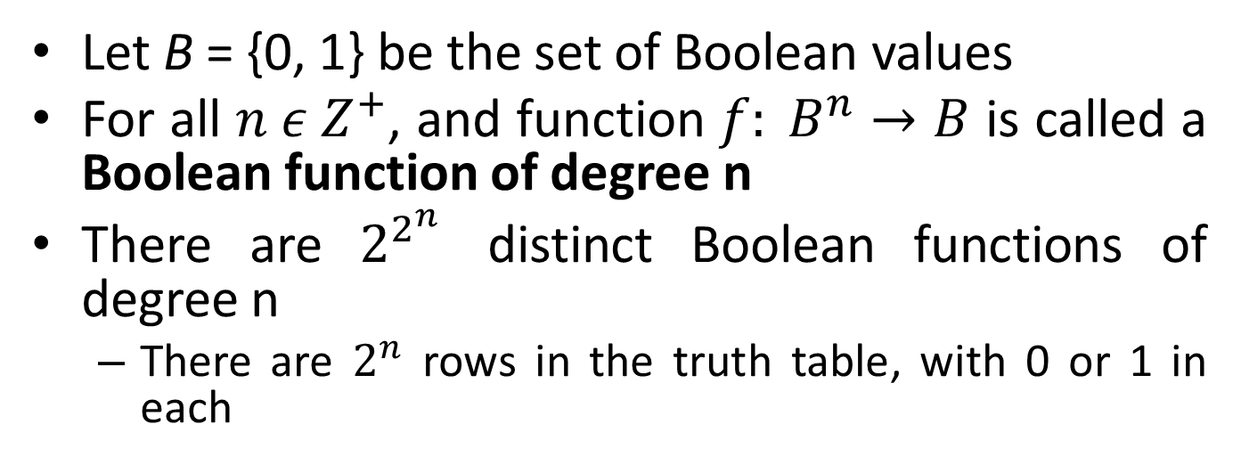
Boolean Functions
Let B = {0, 1} be the set of Boolean values
For all $n ε Z^{+}$, and function $f: B^{n}→B$ is called a Boolean function of degree n
There are $2^{2^{n}}$ distinct Boolean functions of degree n
There are $2^{n}$ rows in the truth table, with 0 or 1 in each

Slide 113

Boolean Functions
Example: Find the values of the Boolean function (of degree 2) F(x, y) = x $\overline{y}$.
Solution:

Slide 114

Boolean Functions
Example 3 Find the values of Boolean function (of degree 3) F(x, y, z) = xy + $\overline{z}$.
Solution:

Slide 115
Boolean Functions of Degree 2

Slide 116
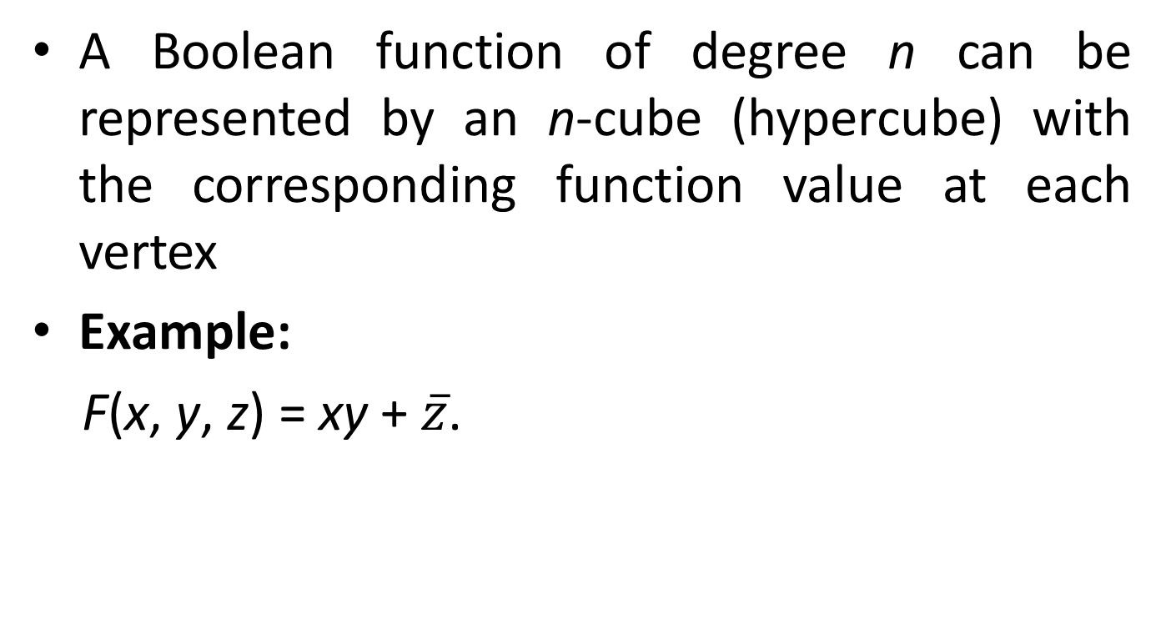
Boolean Function Representation
A Boolean function of degree n can be represented by an n-cube (hypercube) with the corresponding function value at each vertex
Example:
F(x, y, z) = xy + $\overline{z}$.

Slide 117
Boolean Expressions
Let x1, …, xn be n different Boolean variables.
n may be as large as desired.
A Boolean expression (recursive definition) is a string of one of the following forms:
Base cases: 0, 1, x1, …, or xn
Recursive cases: E1, (E1E2), or (E1+E2), where E1 and E2 are Boolean expressions.
A Boolean expression represents a Boolean function
Furthermore, every Boolean function (of a given degree) can be represented by a Boolean expression

Slide 118
Equivalence of Boolean Expressions
Definition: Two Boolean expressions e1 and e2 that represent the exact same function f are called equivalent.
We write e1⇔e2, or just e1 = e2
Implicitly, the two expressions have the same value for all values of the free variables appearing in e1 and e2

Slide 119
Operations on Boolean Expression
The operators ¯, +, and · can be extended from operating on expressions to operations on functions that they represent, in the obvious way

Slide 120
Identities of Boolean Algebra
Boolean Identities

Slide 121
Boolean Identities
Proof of x( y + z) = xy + xz

Slide 122
Boolean Identities
Proof of the Absorption Law x(x + y) = x

Slide 123
Duality
Definition: The dual e^{d} of a Boolean expression e representing function f is obtained by exchanging + with ·, and 0 with 1 in e.
The function represented by e^{d} is denoted f^{d}
Duality principle: If e₁⇔e₂ then e₁^{d} ⇔e₂^{d}.
Example: The equivalence x(x+y) = x implies (and is implied by) x + xy = x.

Slide 124
Duality
Example: Find the dual of the Boolean expressions
Solution:

Slide 125
Abstract Definition of Boolean Algebra

Slide 126
Boolean Algebras
Any Boolean algebra can be proven to satisfy all the theorems of “ordinary” Boolean algebra!
An example of another Boolean algebra:
Boolean algebras can also be defined in terms of lattices (posets where every pair x,y has a lub and a glb)
A complemented, distributed lattice is a Boolean Algebra

Slide 127
Section 10: Representation of Boolean Functions

Slide 128
Outline
Sum-of-Products
Disjunctive Normal Form (DNF)
Product-of-Sums
Conjunctive Normal Form (CNF)
Functional Completeness
Minimal functionally complete sets of operators

Slide 129
Sum of Products (DNF)
Example: Find the Boolean expressions that represent the function F(x, y, z) and G(x, y, z)
Solution:

Slide 130
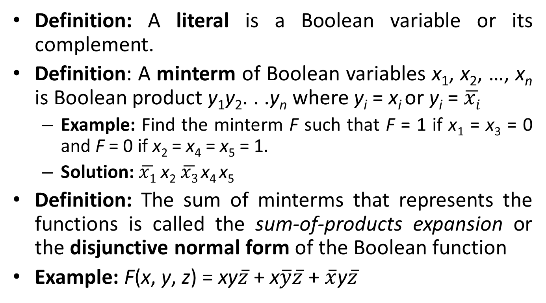
Sum of Products (DNF)
Definition: A literal is a Boolean variable or its complement.
Definition: A minterm of Boolean variables x₁, x₂, …, x_{n} is Boolean product y₁y₂. . .y_{n} where y_{i} = x_{i} or y_{i} = $\overline{xi}$
Example: Find the minterm F such that F = 1 if x₁ = x₃ = 0 and F = 0 if x₂ = x₄ = x₅ = 1.
Solution: $\overline{x1}$ x₂ $\overline{x3}$ x₄ x₅
Definition: The sum of minterms that represents the functions is called the sum-of-products expansion or the disjunctive normal form of the Boolean function
Example: F(x, y, z) = xy$\overline{z}$ + x$\overline{y}\overline{z}$ + $\overline{x}$y$\overline{z}$

Slide 131

Sum of Products (DNF)
Example: Find the sum-of-product expansion for the function F(x, y, z) = (x + y) $\overline{z}$
Solution: (i)
Therefore, F(x, y, z) = xy$\overline{z}$ + x$\overline{y}\overline{z}$ + $\overline{x}$y$\overline{z}$

Slide 132

Sum of Products (DNF)
Solution: (ii)
Therefore, F(x, y, z) = xy$\overline{z}$ + x$\overline{y}\overline{z}$ + $\overline{x}$y$\overline{z}$

Slide 133
Sum of Products (DNF)
Theorem: Any Boolean function can be represented as a sum of products of variables and their complements.
Proof: By construction, from the function’s truth table. For each row that is 1, include a term in the sum that is a product representing the condition that the variables have the values given for that row

Slide 134
Sum of Products (DNF)
Since each minterm is product of n literals, at most one minterm can have a value 1
The Disjunctive Normal Form (DNF) representation of a degree-n Boolean function f is the unique sum of minterms of the variables
Also termed sum-of-products expansion of f

Slide 135
Conjunctive Normal Form
Definition: A maxterm is a sum of literals.
Definition: CNF is a product-of-maxterms representation of Boolean functions
Generating CNF from DNF:
Take the DNF representation for complement ¬f,
¬f = Σ_{i} Π_{j} y_{i,j}
Then, complement both the sides, apply De Morgan’s Laws:
f = Π_{i} Σ_{j} ¬y_{i,j}

Slide 136
Conjunctive Normal Form
Generating CNF Directly from the Truth Table
Use the rows of the Truth Table of f where its value is 0
Example:
F(x, y, z) =
G(x, y, z) =

Slide 137
Functional Completeness
Definition: Since every Boolean function can be expressed in terms of the set of operators is termed functionally complete
There are other sets that are also functionally complete
We can eliminate either . or + using DeMorgan’s Laws
NAND and NOR are also functionally complete (as singleton set:

Slide 138
Reversible Boolean Logic
Definition: A reversible Boolean function of degree n is a bijective function f: B^{n} ↔B^{n}
Corresponds to a permutation of B^{n}
Reversible unary and binary Boolean operators are bijective operators on B and B², respectively
It turns out that no set of reversible unary and binary Boolean operators are functionally complete
However, there are many ternary reversible operators that are functionally complete

Slide 139
Summary
Abstract Algebra deals with the study of discrete mathematical structures based on their algebraic properties
Boolean Algebra, Set Identities, Propositional Identities as well as Groups, Fields, Rings formed by integer and modular arithmetic are studied as Abstract Algebraic structures
Equivalence Classes are induced by Equivalence Relations
Logic circuits are modelled using Boolean Functions
Boolean Functions and Boolean Algebra is employed to design logic circuits using logic gates

